Slide 1
Business Analytics
Session 2: OPTIMIZATION I

Slide 2
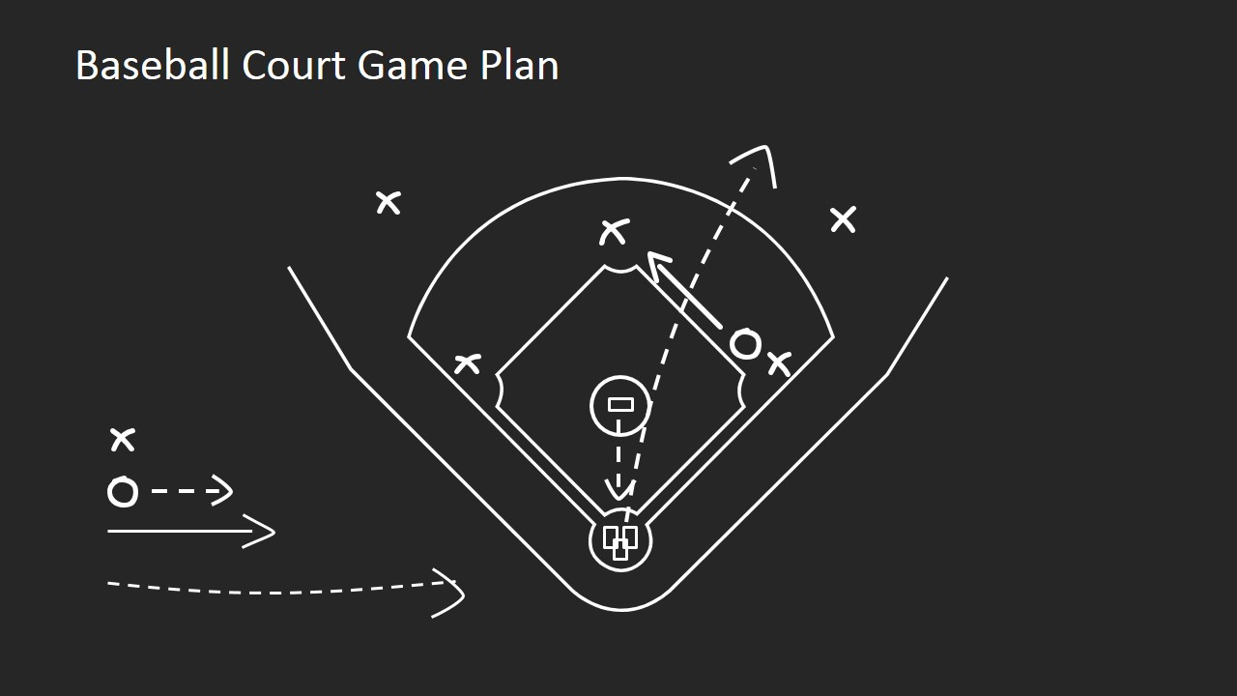
GAME PLAN
GAP for optimization, Solver
Intro to Optimization; linear vs nonlinear
Optimization Example: Product Mix (Golf Bags)

Slide 3
GAME PLAN
GAP for optimization, Solver
Intro to Optimization; linear vs nonlinear
Optimization Example: Product Mix (Golf Bags)

Slide 4
This week
Artificial Intelligence
Prescriptive Analytics
Predictive Analytics
Optimization (II, III)
Value
Diagnostic Analytics
Forecasting (I)
Descriptive Analytics
Extract, Transform, Load
Difficulty

Slide 5



A network model: Shortest Path
C
2H
A
3H
1H
2H
D
2H
1H
3H
B
3H
2H
E

Slide 6
A network model: Shortest Path
C
2H
A
3H
1H
2H
D
2H
1H
3H
B
3H
2H
E

Slide 7
A network model: Shortest Path
C
2H
A
3H
1H
2H
D
2H
1H
3H
B
3H
2H
E
DC→A→D→BAL is shortest path; travel time = 5H

Slide 8
A network model: Shortest Path
C
2H
A
3H
1H
2H
D
2H
1H
3H
B
3H
2H
E
Objectives? Random Variables? Decision variables? Constraints?

Slide 9
Generalized Analytics Procedure (GAP)
Define Model in Words
O: Objective
R: Random Variables
D: Decision Variables
C: Constraints
Formulate Model Mathematically
D: Define Decision Variables
R: Define Random Variables
O: Define Objective Function in terms of Decision Variables
C: Define Constraints in terms of Decision Variables
Solve for Optimal Solution

Slide 10
Objectives, Decision Variables, Constraints
Objective: The primary measurement you want to maximize/minimize
Decision Variables: The decisions you make that affect your objective
Constraints: The limits you have on your decision variables

Slide 11
GAP: Words
Define Model in Words
O: Objective
D: Decision Variables
C: Constraints
Minimize travel time from DC to BAL
Which connections(arcs) to take
Can only move within the network, i.e.
from DC to A or B,
from A to C or D
etc…
C
A
2H
3H
1H
2H
D
1H
2H
3H
B
3H
2H
E

Slide 12
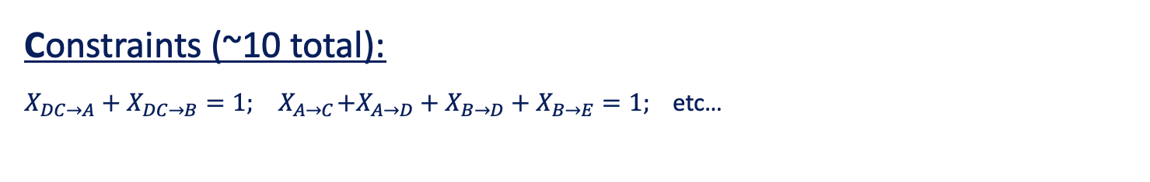
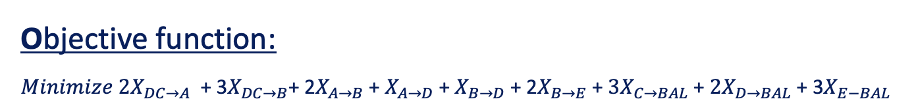
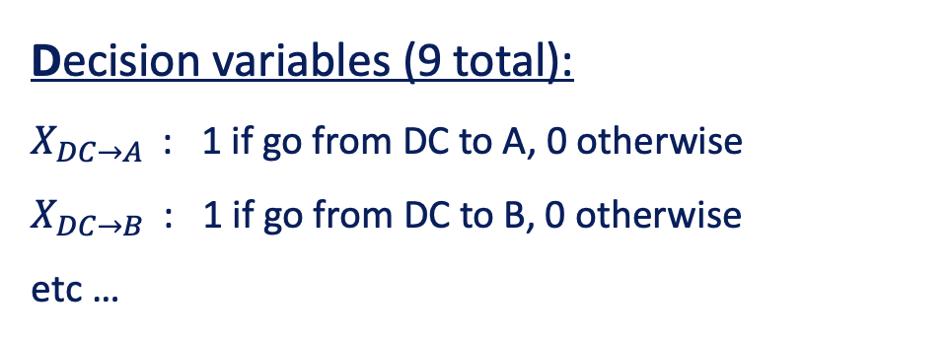
An analytical solution
Decision variables (9 total):
$X_{DC→A}$ : 1 if go from DC to A, 0 otherwise
$X_{DC→B}$ : 1 if go from DC to B, 0 otherwise
etc …
C
A
2H
3H
2H
1H
D
1H
2H
3H
B
3H
2H
E
Objective function:
$Minimize 2X_{DC→A}$ + 3$X_{DC→B}\text{+ 2}X_{A→B}$ + $X_{A→D}$+ $X_{B→D}$+ 2$X_{B→E}$ + ${3X}_{C→BAL}$+ ${2X}_{D→BAL}$+ 3$X_{E−BAL}$
Constraints (~10 total):
$X_{DC→A}+X_{DC→B}=1; { X}_{A→C}+X_{A→D}+X_{B→D}+X_{B→E}=1;$etc…

Slide 13

Intuition vs Math
Some simple problems can be solved by enumeration (“eyeballing”). Most real-world optimization problems need math/software to find the optimum.

Slide 14
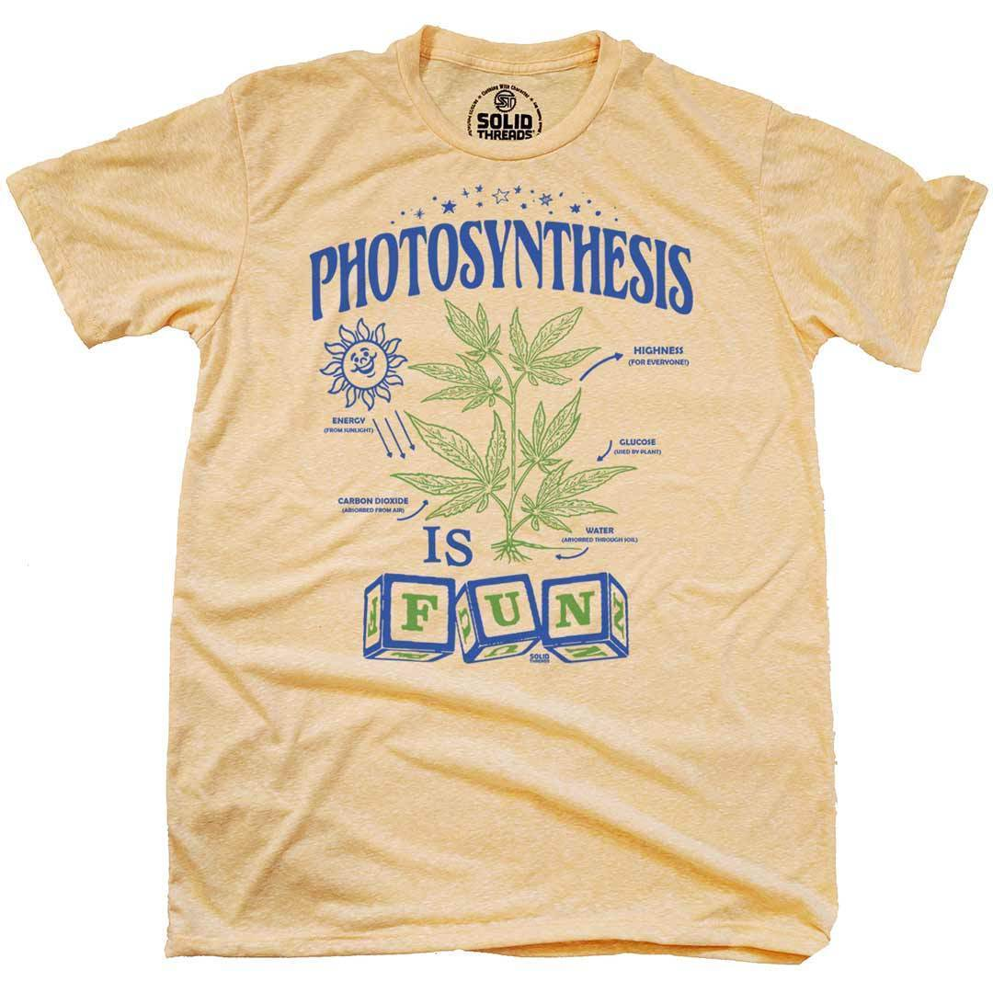


T-Shirt Trove Exercise
See “T-Shirt Trove Description.docx” for problem description

Slide 15
T-Shirt Trove: Part 1
Price | Quantity | Sales?
$20 | 80 | 1600
$40 | 60 | 2400
$60 | 40 | 2400
$80 | 20 | 1600
What is the best price?

Slide 16
Generalized Analytics Procedure (GAP)
Define Model in Words
O: Objective
R: Random Variables
D: Decision Variables
C: Constraints
Formulate Model Mathematically
D: Define Decision Variables
R: Define Random Variables
O: Define Objective Function in terms of Decision Variables
C: Define Constraints in terms of Decision Variables
Solve for Optimal Solution

Slide 17
T-Shirt Trove: Part 1 GAP
Define Model in Words
O: Objective
D: Decision Variables
C: Constraints
Formulate Model Mathematically
D: Define Decision Variables
O: Define Objective Function in terms of Decision Variables
C: Define Constraints in terms of Decision Variables
(Maximize sales)
(T-Shirt Price)
(Price = p)
(Sales = Price * Quantity or S = p * q)

Slide 18
T-Shirt Trove: Part 1 Solution Method
Price | Quantity | Sales
$20 | 80
$40 | 60
$60 | 40
$80 | 20
Solution Method: Enumeration
Solution?

Slide 19
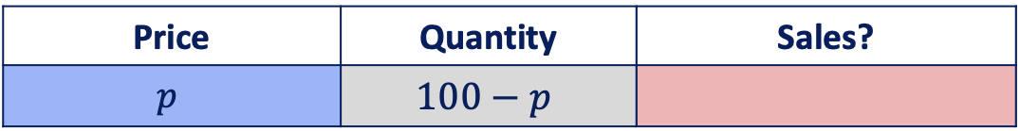
T-Shirt Trove: Part 2
What is the best price?
Price | Quantity | Sales?
$$p$$ | $$100−p$$

Slide 20
T-Shirt Trove: Part 2 GAP
Define Model in Words
O: Objective
D: Decision Variables
C: Constraints
Formulate Model Mathematically
D: Define Decision Variables
O: Define Objective Function in terms of Decision Variables
C: Define Constraints in terms of Decision Variables
(Maximize sales)
(T-Shirt Price)
(Price = p)
($Sales = Price × Quantity$→ $S = p × (100−p))$

Slide 21
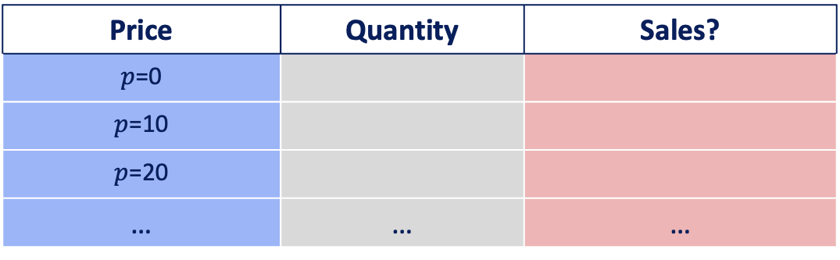
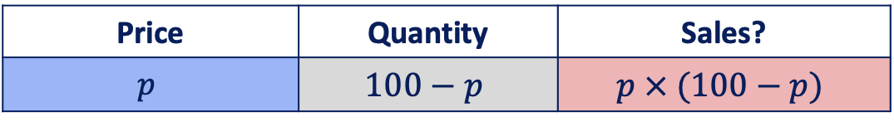
T-Shirt Trove: Part 2
What is the best price?
Price | Quantity | Sales?
$$p$$ | $$100−p$$ | $$p × (100−p)$$
Let’s try some values for price $p$:
Price | Quantity | Sales?
$p$=0
$p$=10
$p$=20
… | … | …

Slide 22

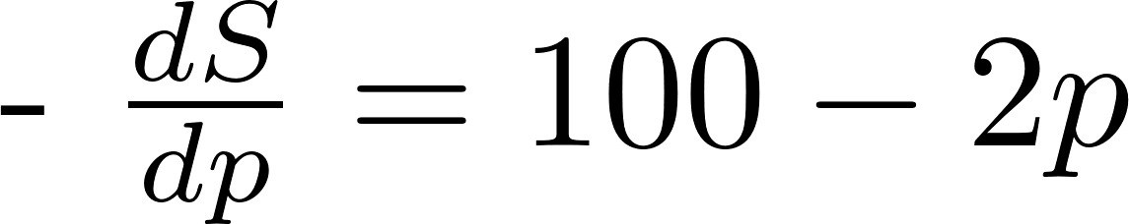
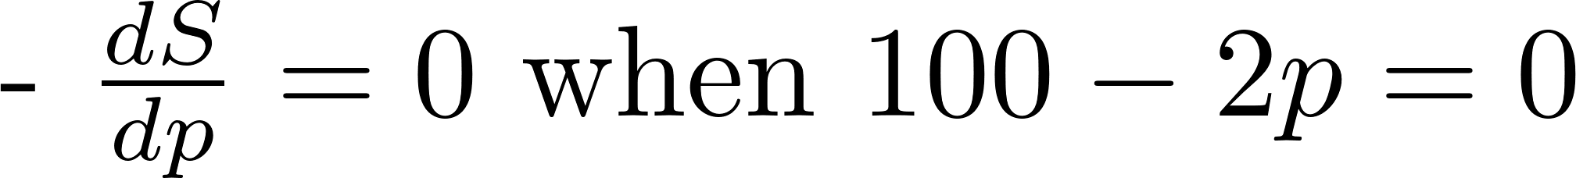
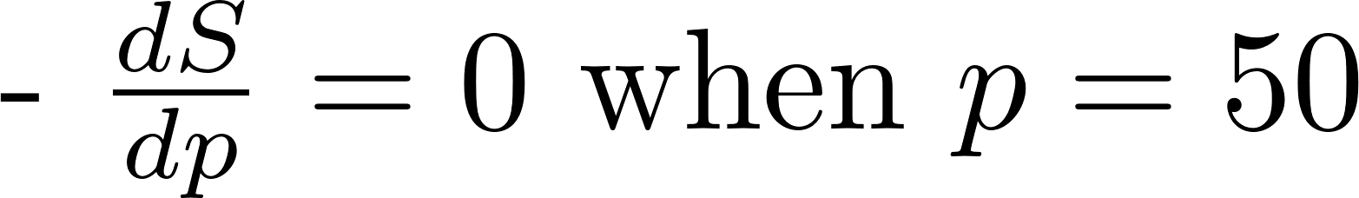
T-Shirt Trove: Part 2 Solution Method
Price of $50
maximizes sales
Solve for Optimal Price
Solution: Optimal Price is $50
Solution Method: Plotting
Solution: Optimal Price is $50
Solution Method: Calculus

Slide 23
Excel solver
Solution method 3: Excel
Install Solver on your Excel: instructions are under the link below (Solver is free and available on PC/Mac)
https://support.microsoft.com/en-us/office/load-the-solver-add-in-in-excel-612926fc-d53b-46b4-872c-e24772f078ca#OfficeVersion=Windows

Slide 24
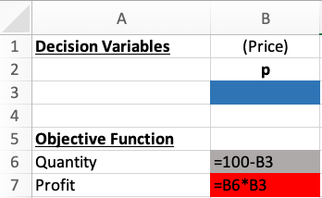
T-Shirt trove part 2: Solution Method: Excel Solver
Decision variables (leave empty)
Information supplied in problem text
Objective function (Optimize!)

Slide 25
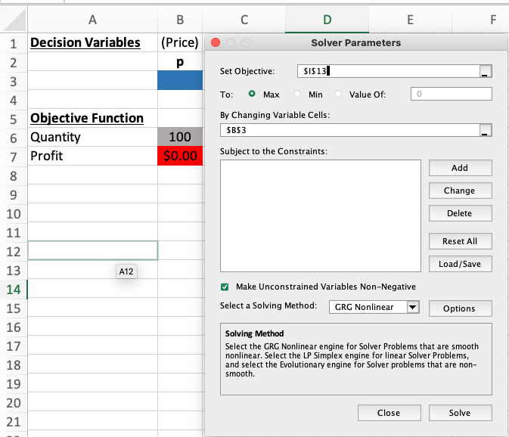
T-Shirt trove part 2: Solver menu
Objective function (Max)
Decision variables
Constraints (none here)

Slide 26
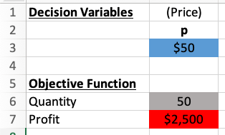
T-Shirt trove part 2: solution
Price of $50
maximizes sales
Price of $50
maximizes sales
Solution: Optimal Price is $50
Solution Method: Plotting

Slide 27
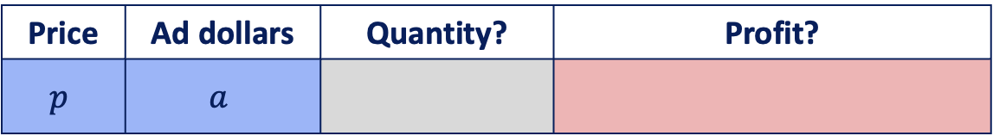
T-Shirt Trove: Part 3
Price | Ad dollars | Quantity? | Profit?
$$p$$ | $$a$$
Solution must satisfy:
Price must be at least $50
Cannot spend more than $1000 on ads

Slide 28
T-Shirt Trove: Part 3 GAP
Define Model in Words
O: Objective
D: Decision Variables
C: Constraints
Formulate Model Mathematically
D: Define Decision Variables
O: Define Objective Function in terms of Decision Variables
C: Define Constraints in terms of Decision Variables
(Maximize Profit)
(T-Shirt Price, Advertising Dollars)
(Min $50 Price, Max $1,000 Advertising Dollars)
(Price = p, Advertising Dollars = a)
(Profit = Price * Quantity – Advertising)
(Profit = $p × q – a$ → Profit = p $×$ ($100 – p + \sqrt{a}) – a$)
$p ≥ 50,$
$a ≤ 1000$

Slide 29
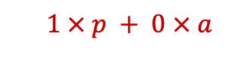
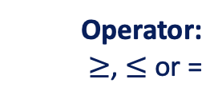

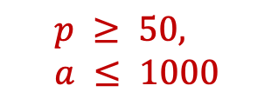

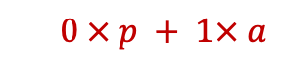
Linear Constraint Sets
$$p ≥ 50,$$
$$a ≤ 1000$$
Linear constraint set: a linear combination of the decision variables:
Left-hand Side (LHS):
sum of each decision variable multiplied by a coefficient,
Operator: $≥$, $≤$ or =
Right-Hand Side (RHS): a constant parameter (number indicating the limit)
L.H.S | Op. | R.H.S.
$$1 × p + 0 × a$$
$$≥$$
50
$$0 × p + 1× a$$
$$≤$$
1000

Slide 30
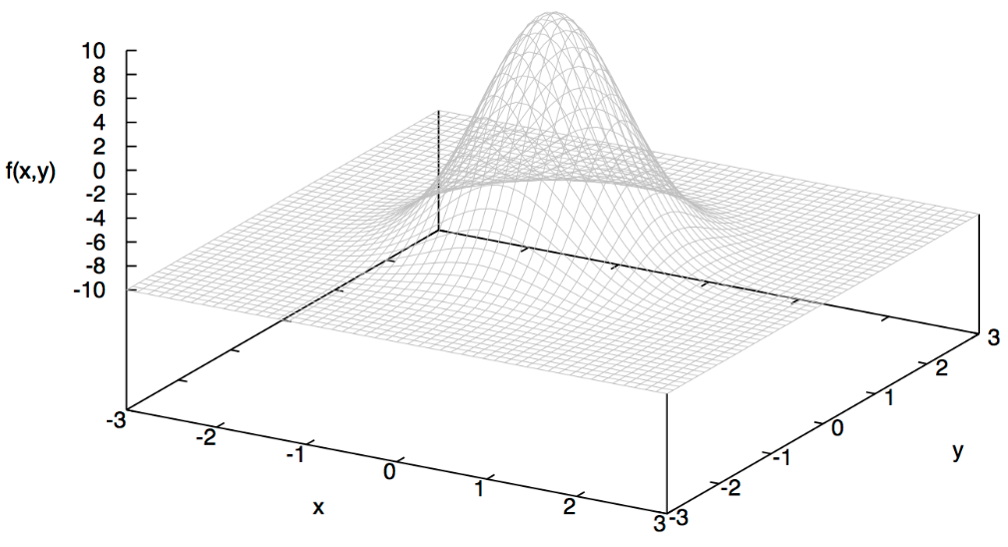
1 variable vs 2 variables
What price and ad dollar combination
maximizes profit?
Price of $50
maximizes sales
Profit
ad dollars
Price
1 decision variable → 2 dimensions
2 decision variables → 3 dimensions

Slide 31
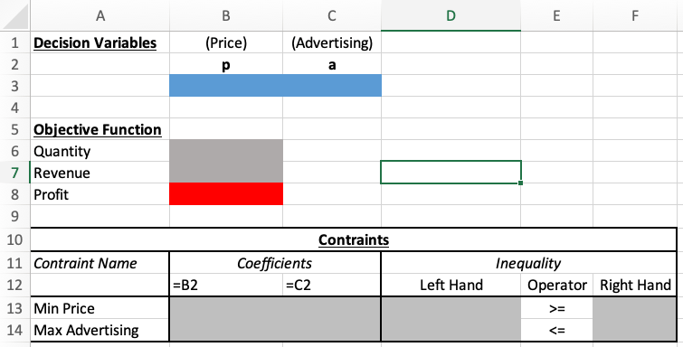
T-Shirt trove part 3: Setup
Decision variables (leave empty)
Objective function (Optimize!)
Parameters and other relevant info supplied in problem text

Slide 32
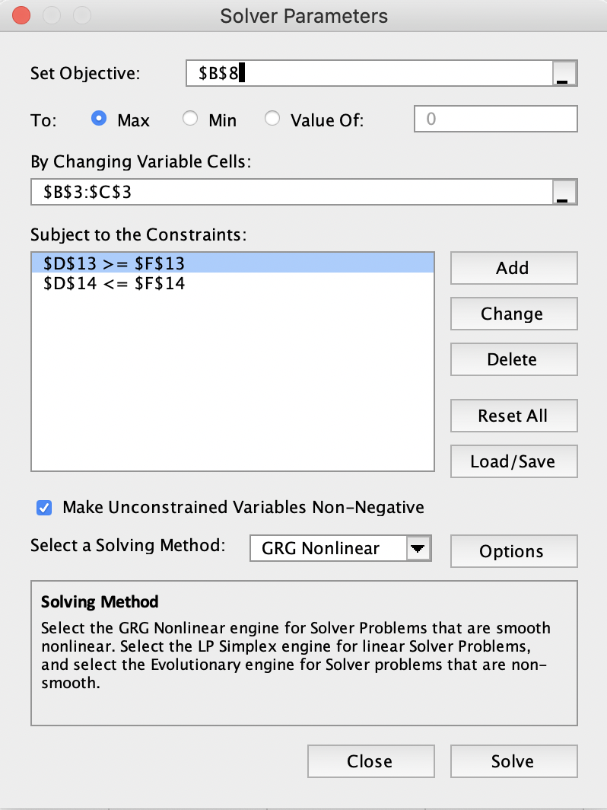
T-Shirt trove part 3: Solver menu
Objective function (Max)
Decision variables
Constraints

Slide 33
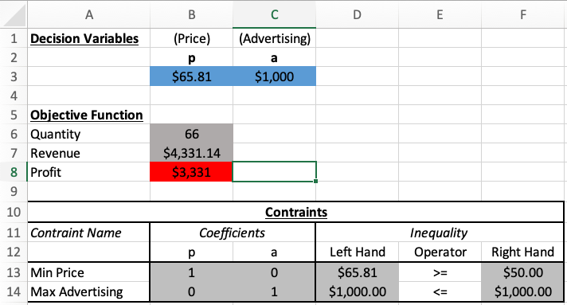
T-Shirt trove part 3: solution
Decision variables populated by solver
Objective function updated by solver

Slide 34

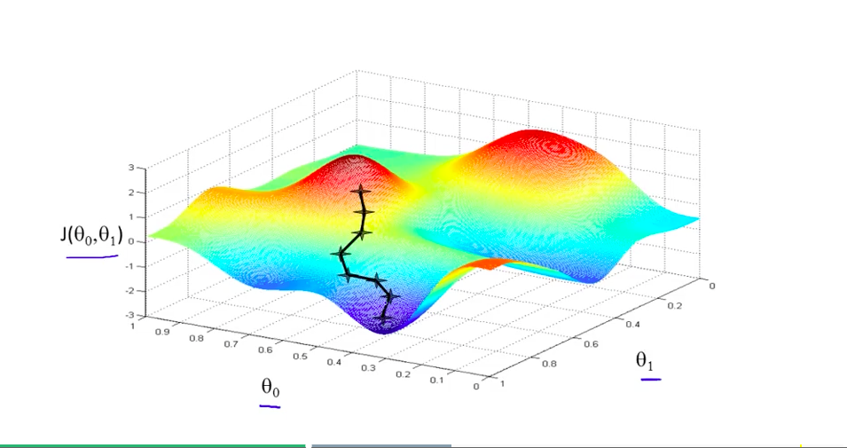
Under the Hood: Gradient Descent Method
One decision variable
Two decision variables

Slide 35
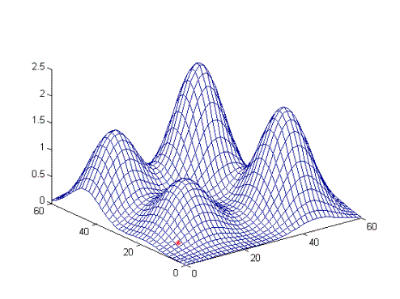
Under the Hood: Beware Local Optima

Slide 36


Slide 37
GAME PLAN
GAP for optimization
Intro to Optimization; linear vs nonlinear
Optimization Example: Product Mix (Golf Bags)

Slide 38

ChatGPT and Optimization
Paste the T-Shirt problem (part 3) into GPT 3.5 and add the following prompt:
Prompt 1: Formulate the following as an optimization problem. What are the decision variables, objective function and constraints? We want to maximize profits.

Slide 39
ChatGPT and Optimization
Paste the T-Shirt problem (part 3) into GPT 3.5 and add the following prompt:
Prompt 2 (follow-up): Give the R code to solve this optimization problem

Slide 40
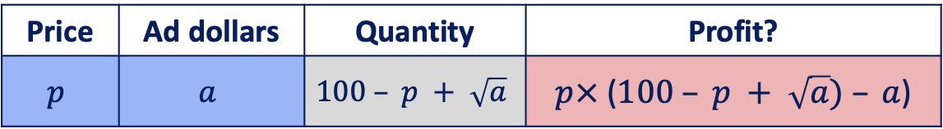

Recall: T-Shirt Trove, Part 3
Price | Ad dollars | Quantity | Profit?
$$p$$ | $$a$$ | $$100 – p + \sqrt{a}$$ | $$p×\text{ (}100 – p + \sqrt{a}) – a\text{)}$$
Solution must satisfy:
$$p >50$$
$$a<1000$$

Slide 41
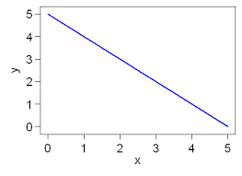

Nonlinear vs Linear
Nonlinear functions
Linear functions

Slide 42
Nonlinear vs Linear Optimization
Optimum/Maximum
Optimum/Maximum
Nonlinear
Linear

Slide 43
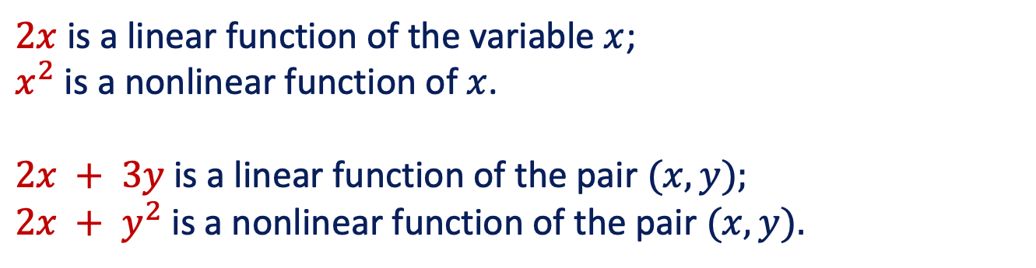
Linear optimization and linear relationships
Linear Relationship Definition: A sum of terms that are variables multiplied by constants
$2x$ is a linear function of the variable $x$;
$x^{2}$ is a nonlinear function of $x$.
$2x + 3y$is a linear function of the pair $(x, y);$
$2x + y^{2}$is a nonlinear function of the pair $(x, y).$

Slide 44


Linear Relationships
Objective/Constraint | Linear?
$$2/z+z≥1$$
$$f\left(x,y \right)=4x−10y+7$$
$$−3A+14.5B≤30$$
$$f\left(x,y \right)=x+\left(15−y/2\right)$$
$$7x−y^{2}≤100$$

Slide 45
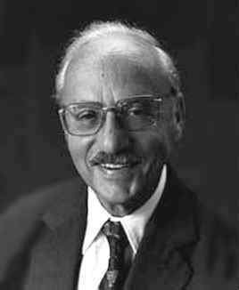
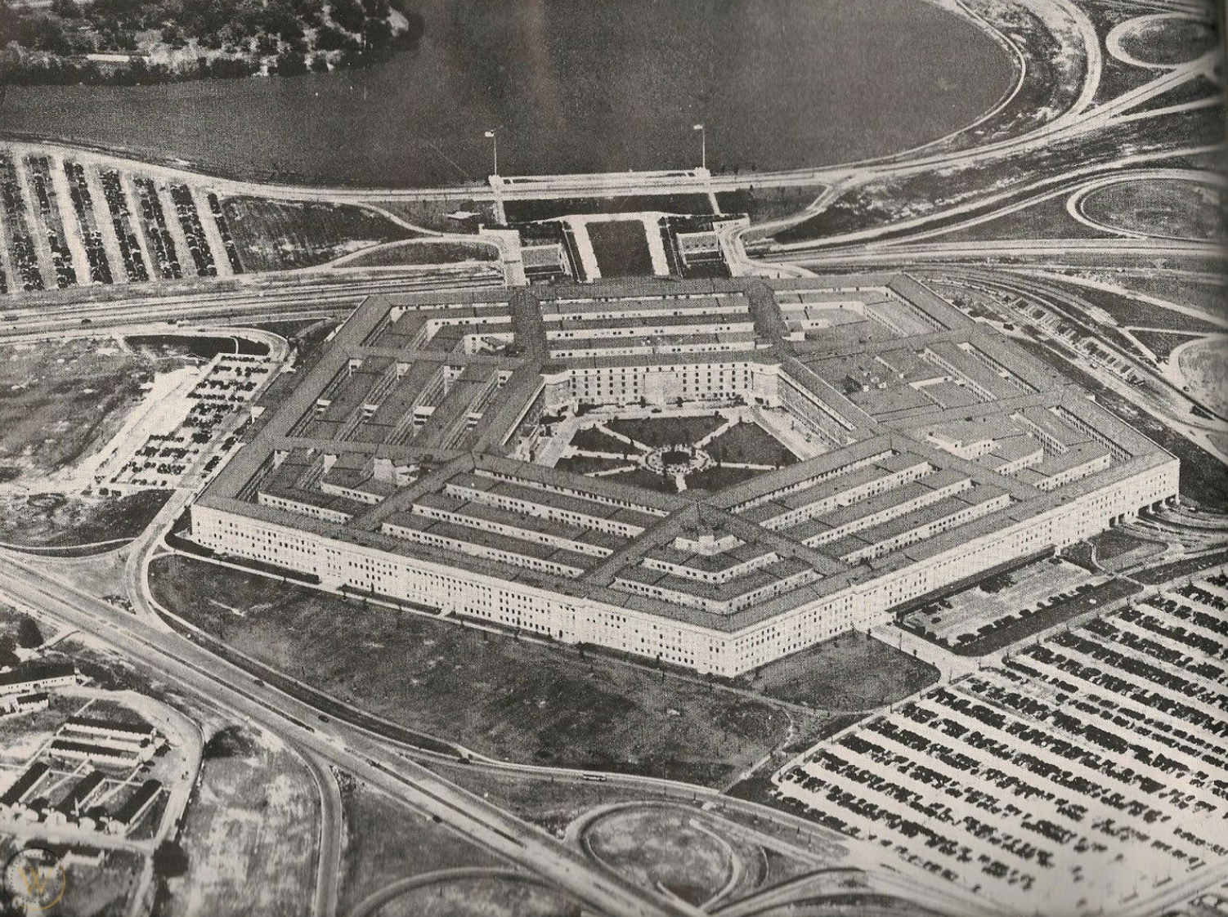
The Father of Linear Programming
In 1946 I was Mathematical Advisor to the US Air Force Comptroller in the Pentagon. I was looking for an academic position that would pay better than a low offer I had received from Berkeley. […] I was asked to find a way to more rapidly compute a time-staged deployment, training and logistical supply program.
G. Dantzig (2002)
G. Dantzig

Slide 46


History of linear programming
Linear Programming was developed to automate deployment/resource allocation for US military
“Programming” in those days (before modern computers) meant developing a plan, organization, or schedule.

Slide 47
Applications of linear programming
Historical
Food & agriculture (e.g. crop optimization, diet)
Engineering (e.g. aerodynamic shape optimization)
Manufacturing
(e.g. machine scheduling)
Transportation
(e.g. truck routing)
Energy
(e.g. power grid planning)
More recent
Finance: Portfolio selection (e.g. in venture capital)
Politics: Campaign planning (e.g. allocating media budget)
Healthcare: public health/hospitals (e.g. distribution of vaccines, nurse staffing, Operating room scheduling)
… and much more!

Slide 48


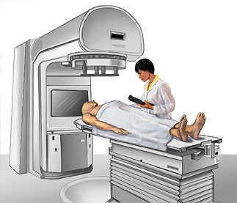
More Advanced Applications
Revenue Management:
Airlines: How should American Airlines sell the right seats to the right customers at the right prices?
Online advertising: How many times should Google display an ad per query to maximize revenue?
Radiotherapy treatment:
How should the beamlet intensities be selected to deliver a therapeutic dose to the tumor and to minimize damage to healthy tissue?

Slide 49
GAME PLAN
GAP for optimization
Intro to Optimization; linear vs nonlinear
Optimization Example: Product Mix (Golf Bags)

Slide 50

Notes:
https://www.youtube.com/watch?v=8DDMHwqIn3s

Slide 51
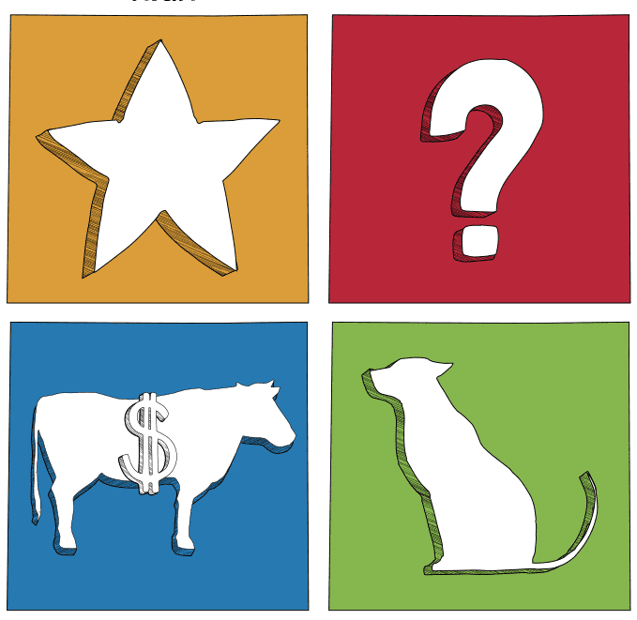

Product Mix
Strategy Perspective
Operational Perspective (This class)

Slide 52

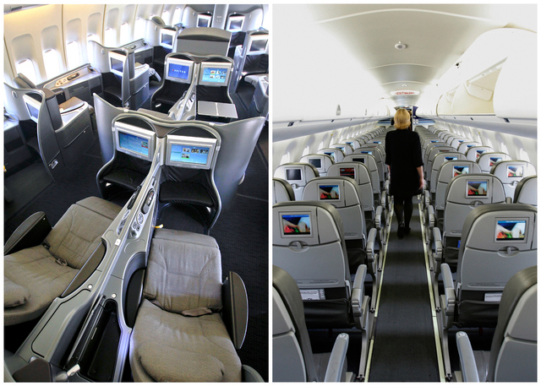


Product mix decisions across industries

Slide 53

Linear Programming: Product mix

Slide 55
Special types of LP problems
“Product mix” problems Allocate scarce production resources to product types (Usually Max)
“Network” problems Find most efficient way from source(s) to destination(s) (Usually Min)
“Covering/staffing/scheduling” problems Minimize cost while ensuring minimum requirements (Usually Min)
“Blending” problems Like covering but with proportionality constraints (Usually Min)

Slide 56
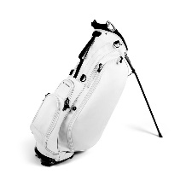
Special types of LP problems
“Product mix” problems Allocate scarce production resources to product types (Usually Max)
“Network” problems Find most efficient way from source(s) to destination(s) (Usually Min)
“Covering/staffing/scheduling” problems Minimize cost while ensuring minimum requirements (Usually Min)
“Blending” problems Like covering but with proportionality constraints (Usually Min)

Slide 57
Product mix
Par, Inc. Manufactures two types of golf bags: standard and deluxe.
The profit contribution of a standard golf bag is $10. The profit contribution of a deluxe golf bag is $9.
The production of golf bags mainly consists of four steps: cutting & dyeing, sewing, finishing, inspection & packaging. Each standard golf bag requires 7/10 hours of cutting dyeing, 1/2 hour of sewing, 1 hour of finishing, and 0.1 hour of inspection & packaging. Each deluxe golf bag requires 1 hours of cutting dyeing, 5/6 hour of sewing, 2/3 hour of finishing, and 1/4 hour of inspection & packaging.
Demand for golf bags is unlimited. However, due to the capacity and labor constraints, each week Par has at most 630 hours of cutting & dyeing, 600 hours of sewing, 708 hours of finishing, and 135 hours of inspection and packaging for the production of golf bags.
How many bags of each type should be produced to maximize weekly profit?

Slide 58
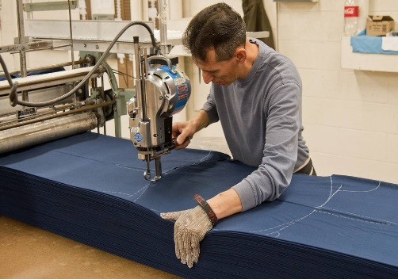

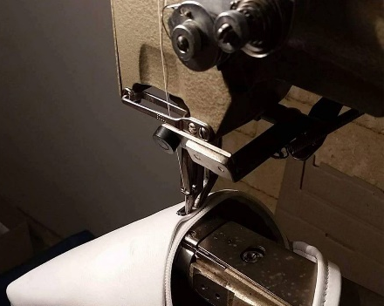

Production Process: Golf Bags
Cutting & Dyeing:
630 hours
Sewing: 600 hours
Finishing: 708 hours
Inspection & Packaging: 135 hours

Slide 59

Breakout Groups
Complete the Google Doc with GAP
Solve problem using Excel Solver
Choose a spokesperson to present results
Notes:
Group 1: https://docs.google.com/document/d/1BJf14lH6kYjN3YnerD_sDWfw8aSCo9M8Z5fWk5phlqE/edit?usp=sharing
Group 2: https://docs.google.com/document/d/1xX6sISRH31dZCBbpFT4cFcNbegmHihmnF5BAu_mBokI/edit?usp=sharing
Group 3: https://docs.google.com/document/d/1BtchMDCYDi5zoJY3aEWxGkyMfbjeEe18CXuskiVp-Lk/edit?usp=sharing
Group 4: https://docs.google.com/document/d/1Thb9UjtKRZfhrUzWzsxv4-lp5FOPF1qdSi8_0lKY9Tk/edit?usp=sharing
Group 5: https://docs.google.com/document/d/1EwtpJIRKDlBybAxE9fd1g0Impa9hvFR-ydqfiNPxPWY/edit?usp=sharing
Group 6: https://docs.google.com/document/d/1x744TTf3rxcnpCLs0u4ahkDl2qwOC4Lx0GY11fNXziQ/edit?usp=sharing
Group 7: https://docs.google.com/document/d/1DGKjDwEy0RL8oeBpajMpRM2E2MKFN411PSH6w-IbQ_o/edit?usp=sharing
Group 8: https://docs.google.com/document/d/1T-XVwag6UqZi6LBQBhL9vo7bOsIMo-Ar6uE9Q47aKos/edit?usp=sharing
Group 9: https://docs.google.com/document/d/1EAN0cd-5cNM0jAzPp9BfG3D3T_-XnmKlqj8lke1hjyQ/edit?usp=sharing

Slide 60
Product Mix: GAP
Define Model in Words
O: Objective
D: Decision Variables
C: Constraints
Formulate Model Mathematically
D: Define Decision Variables
O: Define Objective Function in terms of Decision Variables
C: Define Constraints in terms of Decision Variables
(Maximize Profit)
(# standard bags; # deluxe bags)
(Capacity and labor constraints; 4 total)
(# standard = S, # deluxe = D)
(Profit = 10*S+9*D)
Cutting & Dyeing: 7/10 S + D ≤ 630
Sewing: 1/2 S + 5/6 D ≤ 600
Finishing: S + 2/3 D ≤ 708
Inspection & Packaging: 1/10 S + 1/4 D ≤ 135
S≥ 0, D≥ 0,

Slide 61
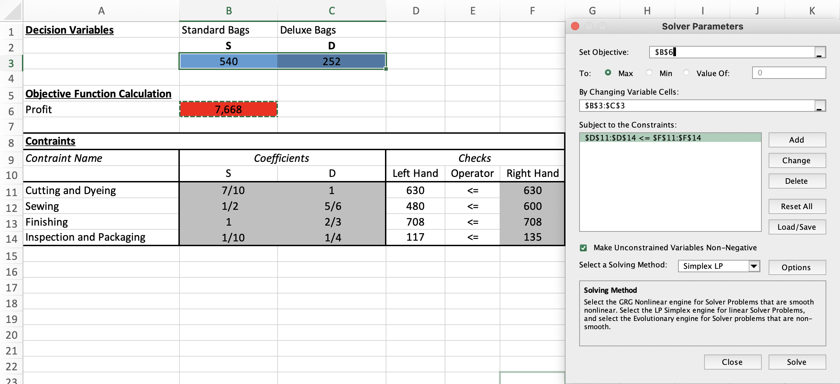
Product Mix: Solver Menu
Objective function
Maximize!
Decision variables
Constraints
Non-negativity
Simplex LP

Slide 62

Sensitivity (What if?) Analysis

Slide 63

Sensitivity (What if?) Analysis
What if?
Types of Sensitivity Analysis:
Change in Objective Function: What happens if profit margins change?
Change in RHS value of constraint: What happens if production capacity changes?

Slide 64
Why sensitivity analysis?
Sensitivity report comes ”for free” whenever you solve an LP
Why do we need to use a report? Can’t we just solve the problem many times using Solver?
Solving the problem multiple times is OK for small spreadsheets, but there are advantages of understanding the Sensitivity report.
Solving multiple times is not practical if there are 1000 constraints.
The SR is a compact way of storing information.

Slide 65
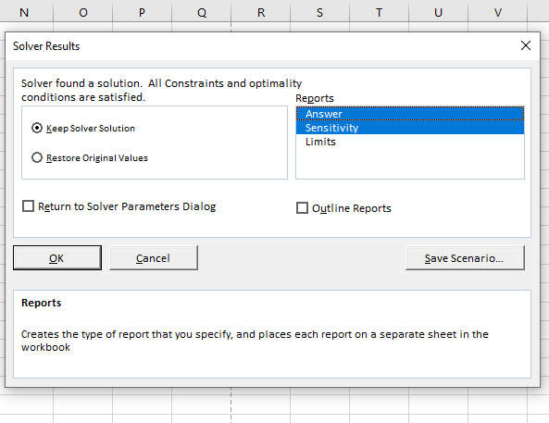
Solver reports
Select “Answer” and “Sensitivity” Reports.

Slide 66
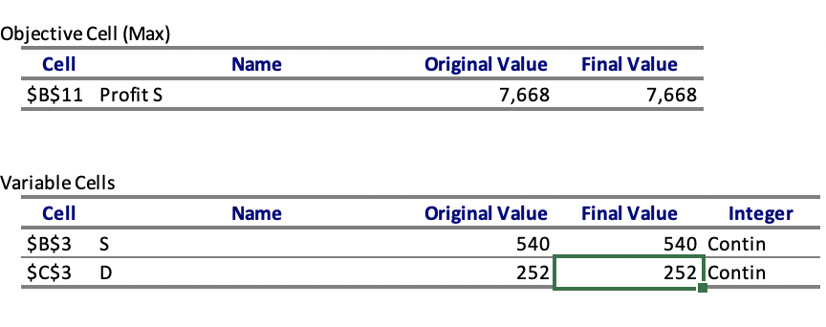
Excel solver: Answer report
Value of objective function at optimal solution
Value of decision variables at optimal solution

Slide 67
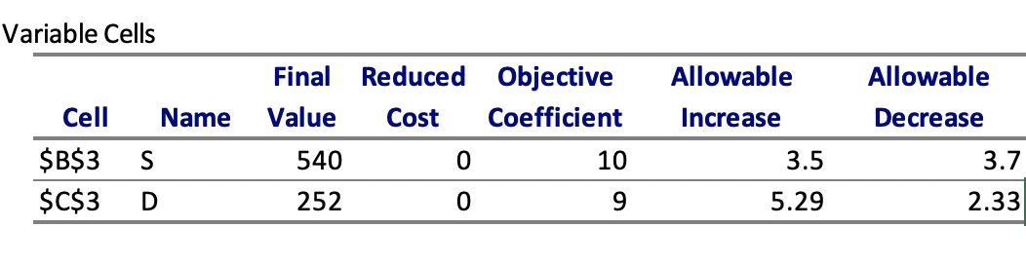
Sensitivity report: objective function
Allowable Increase/Decrease: How much can coefficients change, without changing the optimal solution (optimal values for decision variables)?

Slide 68
Sensitivity report: objective function
Allowable increase/decrease:
How much can the coefficient change without changing optimal decisions?
$10
$6.3
$13.5
Profit margin for S
$9
$6.67
$14.29
Profit margin for D

Slide 69
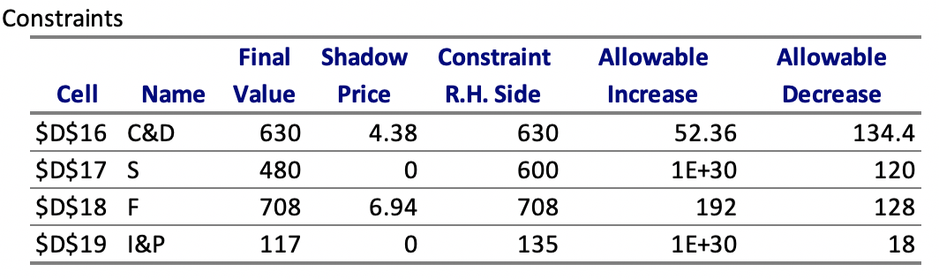
Sensitivity Report
Shadow price: What happens to objective function value if constraint RHS changes by 1 unit?
Allowable Increase/Decrease: How much can each constraint RHS change without changing its shadow price

Slide 70
Sensitivity analysis: constraints
Shadow Price:
How much would the objective function change if constraint RHS changes by 1?
Allowable increase/decrease:
How much can constraint RHS change without changing the constraint shadow price?

Slide 71
Sensitivity analysis: constraints
630h
495.6h
682.36h
RHS limit for C&D
600h
480h
RHS limit for S

Slide 72
Next week
Week 3: More optimization!
HW2: Optimization (Due next week before class)
Group Project proposal (Due next week before class)

Slide 73
Next week
Week 3: More optimization!
HW2: Optimization (Due next week Tuesday before class)
Group Project proposal (Due next week Tuesday before class)

